Slide 1

Automotive Technology: A Systems Approach, 8e
Chapter 34: Emission Control Diagnosis and Service
Rob Thompson and Jack Erjavec, Automotive Technology: A Systems Approach, 8th Edition. © 2025 Cengage. All Rights Reserved. May not be scanned, copied or duplicated, or posted to a publicly accessible website, in whole or in part.

Slide 2
Chapter Objectives (1 of 2)
34.01 Describe types of OBD II emissions tests.
34.02 Explain how exhaust emission testing is performed.
34.03 Explain basic inspection of emissions-related monitoring of an OBD II system.
34.04 Diagnose and service evaporative (EVAP) systems.
34.05 Describe the inspection and replacement of PCV system parts.

Slide 3
Chapter Objectives (2 of 2)
34.06 Diagnose engine performance problems caused by improper EGR operation.
34.07 Check the efficiency of a catalytic converter.
34.08 Diagnose and service secondary air injection systems.

Slide 4
OBD II Test
34.01 Describe types of OBD II emissions tests.
Because of the ability of OBD II systems to monitor and report emission-related failures, many states use a check of the OBD II system as part or all of their mandatory emissions testing program for 1996 and newer vehicles.
The OBD II test can even be performed at self-service testing stations by the vehicle owner.
Checking the OBD II system usually consists of three parts:
  MIL operation, checking for DTCs, and a readiness monitor check.
The MIL operation test verifies that the MIL illuminates with the ignition on and that it goes out once the engine is started.
If the light does not turn on or if it stays on once the engine is running, the vehicle fails this test.
If the MIL stays on, DTCs are checked. If the MIL is off and no DTCs are stored, the readiness monitors are checked.

Slide 5
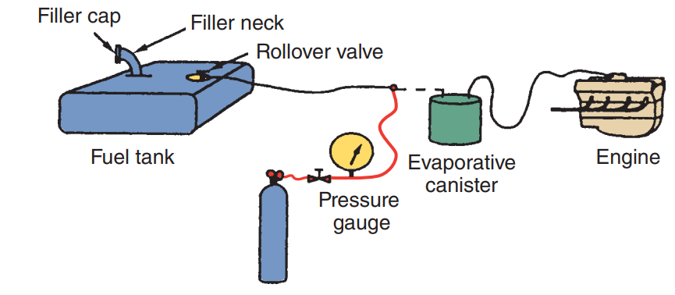
I/M 240 Test
An I/M 240 test checks the emission levels of a vehicle while it is operating under a variety of conditions and loads.
This test gives a true look at the exhaust quality of a vehicle as it is working.
The testing sequence normally begins with a leakage test and a functional test of the EVAP system and a complete visual inspection of the emission control system.
Many states have plans to phase out I/M 240 testing and rely totally on OBD II tests.

Slide 6
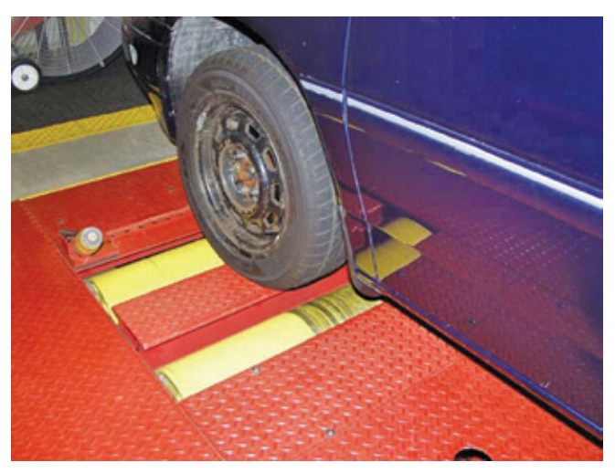
Chassis Dynamometer
Chassis dynamometers are used during the I/M 240 test and can be valuable when diagnosing other driveability problems, including finding the cause of low power, overheating, and speedometer accuracy.
A chassis dyno, or dynamometer, is designed to simulate the various road conditions in which a vehicle is driven.
With a chassis dyno, a vehicle can be driven on rollers.
This allows the vehicle to be driven through the test conditions while it is stationary.

Slide 7
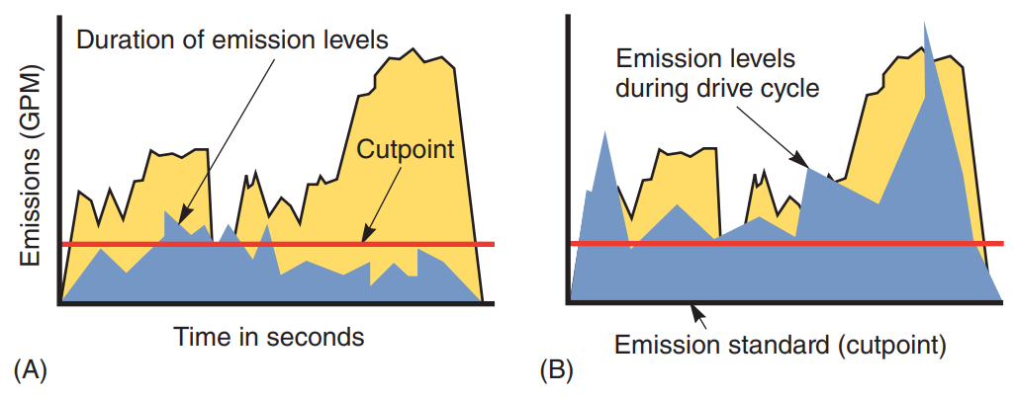
Interpreting the Results of an I/M Test
The report from an I/M 240 test shows the amount of gases emitted during the different speeds and loads of the test.
The report also gives the average output for each of the gases and shows the cutpoint for the various gases.
The cutpoint is the maximum allowable amount of each gas.
A vehicle that fails the test will have many areas of high pollutant output.
To use the report as a diagnostic tool, pay attention to all of the gases and to the loads and speeds at which the vehicle went over the cutpoint.

Slide 8
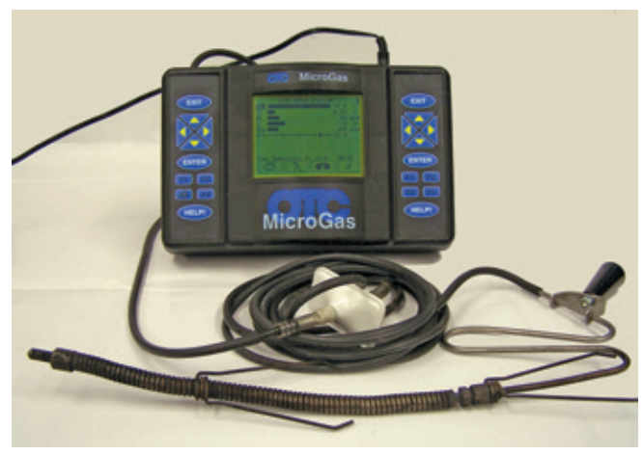
Testing Emissions
Testing the quality of the exhaust is both a procedure for testing emission levels and a diagnostic routine.
An exhaust analyzer is one of the valuable diagnostic tools for driveability problems.
By looking at the quality of an engine’s exhaust, a technician is able to look at the effects of the combustion process.
Any defect can cause a change in exhaust quality. The amount and type of change serve as the basis of diagnostic work.

Slide 9
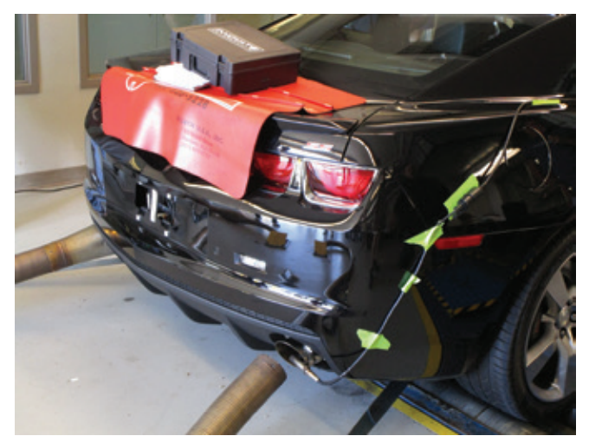
Exhaust Analyzer
34.02 Explain how exhaust emission testing is performed.
Emissions analyzers measure HC in parts per million (ppm) or grams per mile (g/mi.).
CO is an odorless, toxic gas that is the product of combustion and is typically caused by a lack of air or excessive fuel.
CO is typically measured as a percent of the total exhaust.
Before measuring the exhaust gases, disable the air injection system, if the engine is equipped with one.
Start the engine.
Once the engine is warmed up, insert the probe in the tailpipe.

Slide 10
Knowledge Check (1 of 2)
When using an exhaust analyzer, where is the probe placed?

Slide 11
Knowledge Check Answer (1 of 2)
  Answer: The probe is placed in the tailpipe.

Slide 12
Basic Inspection
Before diagnosing the cause of excessive emissions, make sure you inspect the entire vehicle for obvious problems.
The results of the inspection may help pinpoint the cause of the problem.
Here are a few things to check:
  Check the battery’s voltage.
  Inspect/clean the air filter for dirt or contamination.
  Disconnect the air inlet line hose from the charcoal canister. Then check that air can flow freely into the air inlet. If air cannot flow freely, repair or replace it.
  On older vehicles, check and adjust the idle speed.
  On older vehicles, make sure that base timing is set to specifications.
  Check the fuel pressure.
  Check the engine’s mechanical condition.
  Check all accessible electrical connections and vacuum and air induction hoses and ducts.

Slide 13
OBD II Monitors
The OBD II system monitors the emission control systems and components that can affect tailpipe or evaporative emissions.
Through this monitoring process, problems are detected before emissions are 1.5 times greater than applicable emission standards.
Each monitor requires one or more diagnostic tests.
The monitors run continuously or noncontinuously and only when certain enabling criteria have been met.
If a system or component fails these tests, a DTC is stored and the MIL is illuminated within two driving cycles.
A pending DTC is stored in the PCM when a concern is initially detected.
Part of many mandatory I/M inspections is taking a look at the OBD system tests.
This is done by observing the system status display on a scan tool.
If the diagnostic tests for a particular monitor have been completed, the scan tool will indicate this with a YES or COMPLETE.

Slide 14
Evaporative Emission Control System Diagnosis and Service
34.04 Diagnose and service evaporative (EVAP) systems.
Most I/M inspections begin with a check of the EVAP system.
This includes checking the results of the EVAP monitor’s diagnostic tests.
The EVAP system is monitored for leaks and its ability to move fuel vapor when commanded by the PCM to do so.
Problems that are detected will set a DTC.
Normally, this is the only way a driver knows there is an EVAP problem.
At times, the owner may complain of a gasoline odor in or around the vehicle.
The common tools for troubleshooting an EVAP system are a diagnostic tester, smoke machine, and pressure kit.
The exact procedures and tools will vary with each application.

Slide 15
EVAP Monitors
Many different EVAP systems and monitoring systems have been used by the manufacturers.
It is important to correctly identify the system used on a particular vehicle before doing any diagnostic procedures or service on the vehicle.
A system leak can generate multiple DTCs depending on the component and location of the leak.
The monitor also checks the electrical integrity of the system and the vapor purge rate.
All EVAP monitor DTCs require two trips.
To monitor the vapor purge in most systems, the PCM changes the duty cycle of the purge solenoid while monitoring the STFT.
A problem is indicated by uncorrelated changes in the STFT.
Other systems use a pressure sensor to monitor the pressure in the system and the purge side of the charcoal canister.

Slide 16
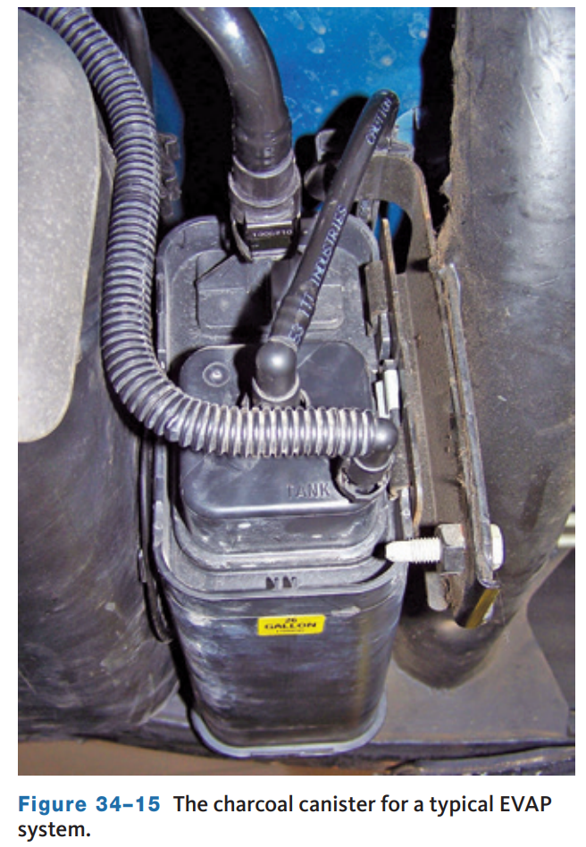
Diagnosis
The entire EVAP system should be carefully inspected.
All of the hoses in the system should be checked for leaks, restrictions, and loose connections.
Repair or replace them as necessary.
Also check the canister for cracks or damage; if they are found, replace the charcoal canister assembly.
The operation of the charcoal canister can be quickly checked on most vehicles.
Close the purge port, gently blow into its vent port, and check that air flows from the port.

Slide 17
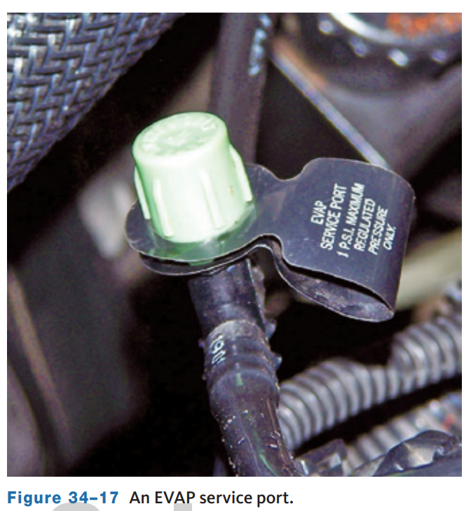
Leak Test
EVAP leak testers pressurize the system with a very low pressure.
Before using an EVAP leak tester, make sure that the fuel tank is at least half full.
The tester kit will include a pressure guideline chart.
The chart contains various size fuel tanks and different fuel levels. Interpreting the chart will let you know how much pressure should be applied to the system.
The tester is normally connected to the EVAP service port.
If the vehicle does not have the service port, use the correct adapter for the vehicle’s filler neck.

Slide 18
PCV System Diagnosis and Service
34.05 Describe the inspection and replacement of PCV system parts.
No adjustments can be made to the PCV system.
Service of the system involves careful inspection, functional tests, and replacement of faulty parts.
Some engines use a fixed orifice tube in place of a valve.
These should be cleaned periodically with a pipe cleaner soaked in carburetor cleaner. Although there is no PCV valve, this type of system is diagnosed in the same way as those systems with a valve.
When replacing a PCV valve, match the part number on the valve with the vehicle maker’s specifications for the proper valve.
If the valve cannot be identified, refer to the part number listed in the manufacturer’s service information.
Newer PCV valves have locking devices that prevent them from becoming loose or falling out.

Slide 19
Consequences of a Faulty PCV System
If the PCV valve is stuck open, excessive airflow through the valve causes a lean air–fuel ratio and possible rough idle or engine stalling.
When the PCV valve or hose is restricted, excessive crankcase pressure forces blowby gases through the clean air hose and filter into the air cleaner.
Worn rings or cylinders cause excessive blowby gases and increased crankcase pressure, which forces blowby gases through the hose and filter into the air cleaner.
A restricted PCV valve or hose may also cause an accumulation of moisture and sludge in the engine and engine oil.
Leaks at the engine gaskets not only will cause oil leaks, but will allow blowby gases to escape into the atmosphere.
The PCV system will also draw unfiltered air through these leaks.
This can result in premature wear of engine parts, especially when the vehicle is operated in dusty conditions.

Slide 20
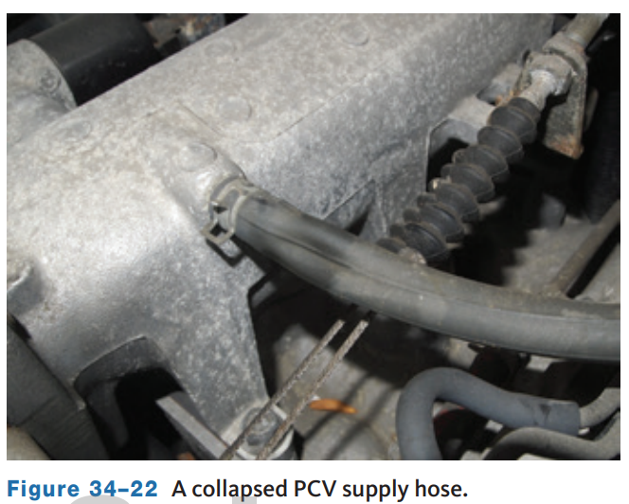
Visual Inspection
The PCV valve can be located in several places.
The most common location is in a rubber grommet in the valve cover.
It can be installed in the middle of the hose connections, as well as directly in the intake manifold.
Once the PCV valve is located, make sure that all the PCV hoses are properly connected, are not collapsed, and have no breaks or cracks.
Remove the air cleaner and inspect the air and crankcase filters.
Crankcase blowby can clog these with oil.

Slide 21
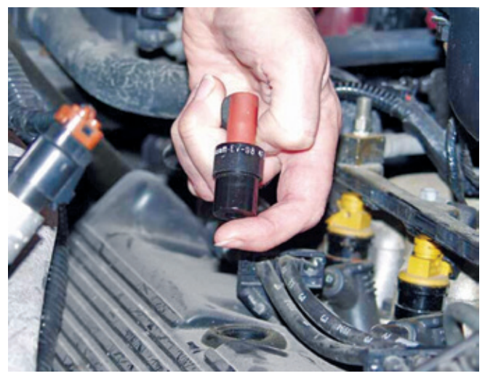
Functional Checks of the PCV System
Start the engine and let it run at idle. If the PCV valve is not clogged, a hissing is heard as air passes through the valve.
Place a finger over the end of the valve to check for vacuum.
If there is little or no vacuum at the valve, check for a plugged or restricted hose. Replace any plugged or deteriorated hoses.
Turn off the engine and remove the PCV valve.
Shake the valve and listen for the rattle of the check needle inside the valve. If the valve does not rattle, replace it.

Slide 22
Measuring Crankcase Pressure
To measure crankcase pressure, bring the engine up to normal operating temperature.
Then connect a water manometer to the dipstick tube after the dipstick has been removed.
With the engine at idle, observe the reading on the meter.
If the reading is greater than 1 inch H₂O, check the crankcase valve.
If the valve is clean and working properly, check the compression and leakage of the cylinders.
If the crankcase pressure is less than 1 inch H₂O, raise the engine to above 2,000 rpm.
If the pressure drops to a negative value of 4 to 5 inches H₂O, the system is okay.
If the drops are more than that, replace the valve.
Keep in mind that a restriction in the air intake system will increase inlet vacuum in turbocharged engines and the intake vacuum on non-turbocharged engines.

Slide 23
EGR System Diagnosis and Service
34.06 Diagnose engine performance problems caused by improper EGR operation.
Manufacturers calibrate the amount of exhaust gas recirculation or EGR flow for each engine.
Too much or too little can cause performance problems by changing the engine’s breathing characteristics.
Also, with too little EGR flow, the engine can overheat, detonate, and emit excessive amounts of NOx .
When any of these problems exist and it seems likely that the EGR system is at fault, check the system.
Typical problems that show up in ported EGR systems follow:
  Rough idle No-start, surging, or stalling
  Detonation
  Excessive NOx emissions
  Poor fuel economy

Slide 24
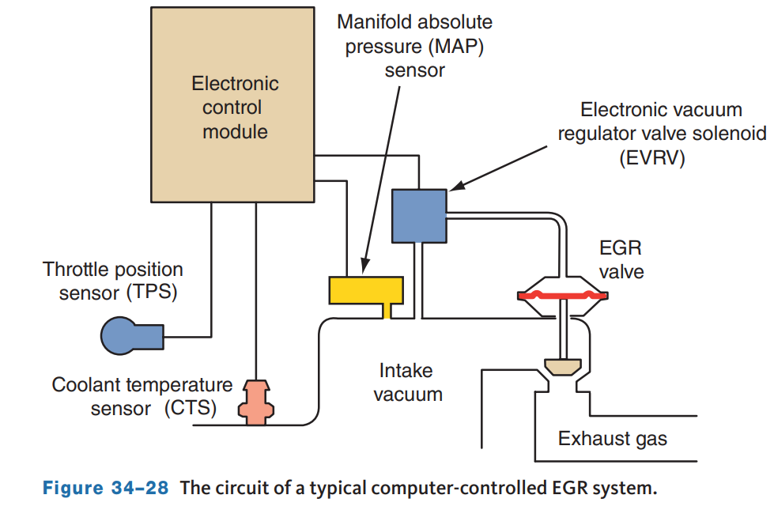
EGR System Troubleshooting
Most often an electronically controlled EGR valve functions in the same way as a vacuum-operated valve.
Apart from the electronic control, the system can have the problems of any EGR system.
Those that are totally electronic and do not use a vacuum signal can have the same problems as others, with the exception of vacuum leaks and other vacuum problems.
Sticking valves, obstructions, and loss of vacuum produce the same symptoms as on non-electronic-controlled systems.
If an electronic control component is not functioning, the condition is usually recognized by the PCM.

Slide 25
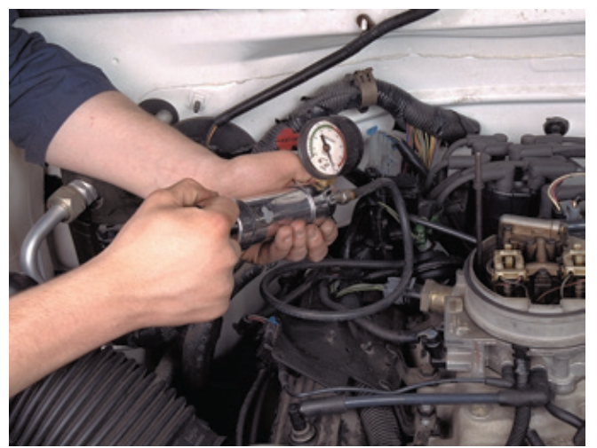
EGR Valves and Systems Testing
On many older engines, a single diaphragm EGR valve can be checked with a hand-operated vacuum pump.
Before conducting this test, make sure that the engine produces enough vacuum to properly operate the valve.
This is done by connecting a vacuum gauge to the engine’s intake manifold.
Then start the engine and gradually increase speed to 2,000 rpm with the transmission in neutral.
The reading should be above 16 inches of mercury. If not, there could be a vacuum leak or exhaust restriction.

Slide 26
Diagnosis of a Negative Backpressure EGR Valve
A negative backpressure EGR valve is identified by the letter “N” stamped on it.
The valve is opened by a combination of engine vacuum and the negative exhaust system pulses that occur as each exhaust valve closes.
As soon as the valve opens, backpressure is reduced slightly, which opens a vacuum bleed and the valve quickly closes.
This causes the opening of the valve to modulate according to negative exhaust system pulses.
With the engine at normal operating temperature and the ignition switch off, disconnect the vacuum hose from the EGR valve and connect a hand vacuum pump to the vacuum fitting on the valve.
Supply 18 inches of vacuum to the EGR valve. The EGR valve should open and hold the vacuum for 20 seconds.
If the valve does not open or cannot hold the vacuum, it must be replaced.

Slide 27
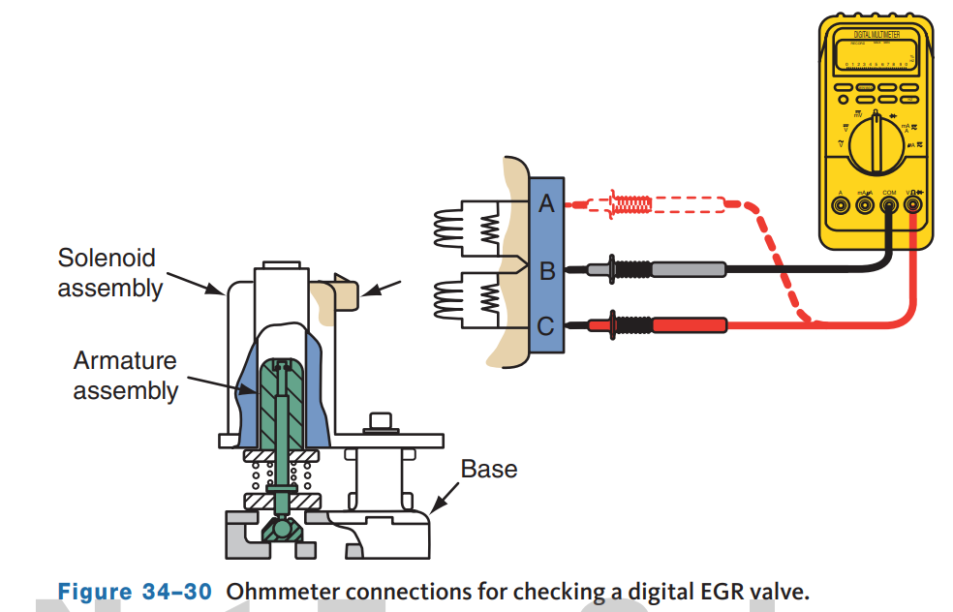
Diagnosis of a Digital EGR Valve
Use a scan tool to check a digital EGR valve. Start the engine and allow it to run at idle speed.
Select the EGR control on the scan tool, and then energize the solenoids one at a time.
Engine speed should drop slightly as each EGR solenoid is energized.
If the EGR valve does not respond correctly, make sure 12 volts are applied to the EGR valve.
Then check the resistance of the valve.
Connect an ohmmeter across the electrical terminals on the valve; the windings can be checked for opens, shorts, and excessive resistance.

Slide 28
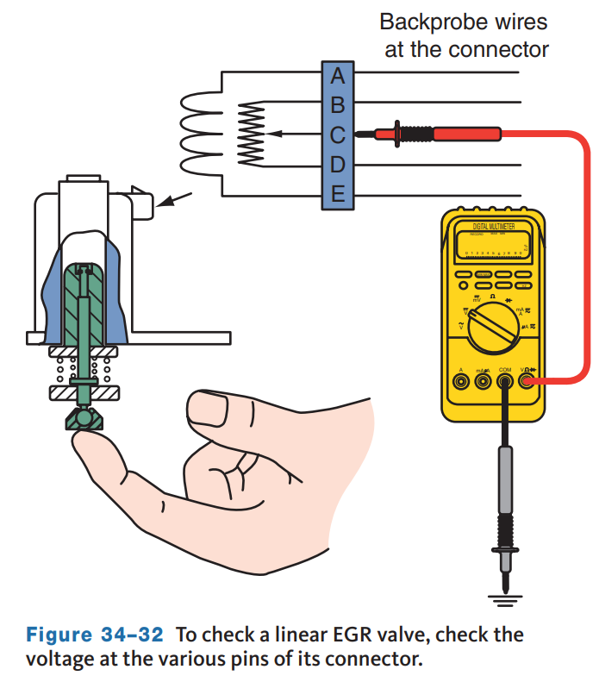
Linear EGR Valve Diagnosis
If a linear EGR valve does not operate properly, check the fuse in the supply wire to the EGR valve.
Check for open circuits, grounds, and shorts in the wires connected from the EGR valve to the PCM.
Verify that the EVP sensor is receiving a 5-volt reference signal and the ground circuit is good.
If these are okay, remove the valve with the wiring harness still connected to it.
Then connect a DMM across the pintle position wire at the EGR valve to ground and manually push the pintle upward.
The voltmeter reading should change from approximately 1 to 4.5 volts.

Slide 29
Checking EGR Efficiency
To check an EGR system, use a five-gas exhaust analyzer.
Allow the engine to warm up, and then raise the engine speed to around 2,000 rpm. Watch the NOx readings on the analyzer.
In most cases, NOx should be below 1,000 ppm.
It is normal to have some temporary increases over 1,000 ppm; however, the reading should be generally less than 1,000.
If the NOx is above 1,000, the EGR system is not doing its job.
The exhaust passage in the valve is probably clogged with carbon.
If only a small amount of exhaust gas is entering the cylinder, NOx will still be formed.
A restricted exhaust passage of only 1/8 inch will still cause the engine to run rough or stall at idle, but it is not enough to control combustion chamber temperatures at higher engine speeds.
Never assume that the EGR passages are okay just because the engine stalls at idle when the EGR is fully opened.

Slide 30
EGR Vacuum Regulator (EVR) Tests
Connect a pair of ohmmeter leads to the EVR terminals to check the winding for open circuits and shorts.
An infinite ohmmeter reading indicates an open circuit, whereas a lower-than-specified reading means the winding is shorted.
Then connect the ohmmeter leads from one of the EVR solenoid terminals to the solenoid case.
You should get an infinite reading; a low ohmmeter reading means the winding is shorted to the case.
A scan tool can also be used to diagnose the operation of an EVR solenoid.

Slide 31
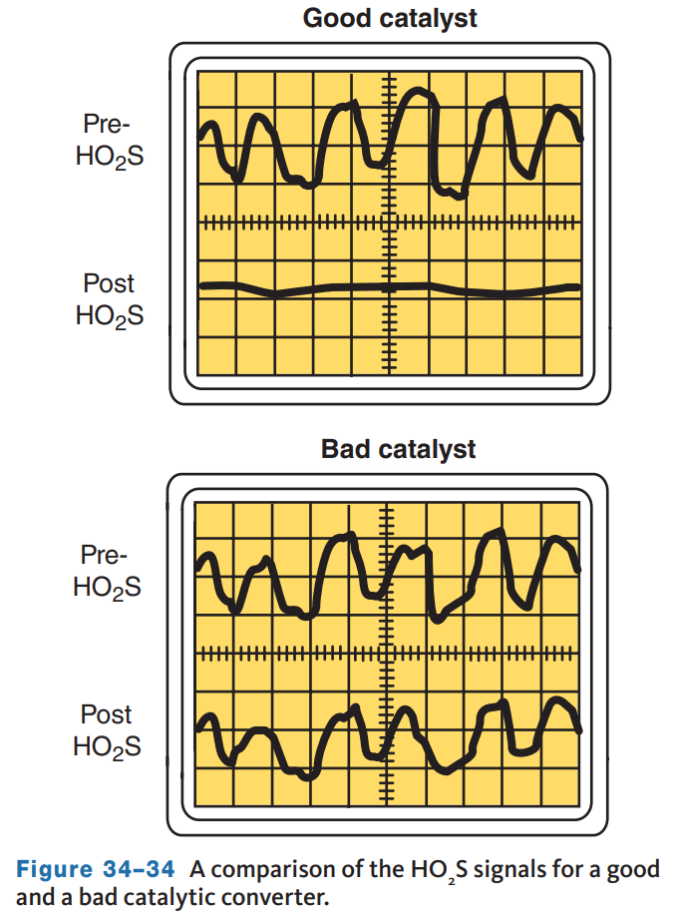
Catalytic Converter Diagnosis
36.07 Check the efficiency of a catalytic converter.
The catalytic converter monitor looks at a converter’s ability to store O₂.
Oxygen storage is only one function of a converter but is a good indication of how efficient the converter is.
As the catalyst efficiency declines due to thermal and chemical deterioration, its ability to store O₂ also declines.
Therefore, OBD II systems compare the O₂ content in the exhaust before and after the converter.
This is done by monitoring the signals from O₂ sensors placed before and after the converter.

Slide 32
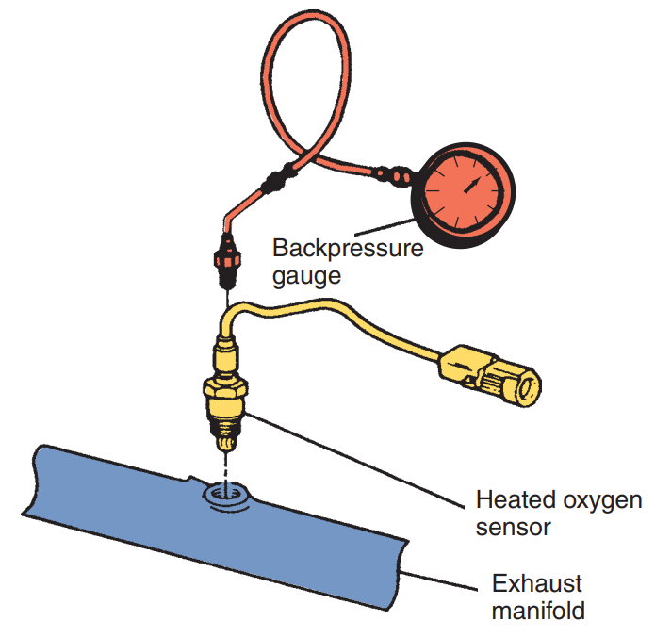
Converter Diagnosis
Converters often fail because the catalyst material becomes coated with foreign materials.
A buildup of this material reduces the catalysts’ ability to reduce NOx and oxidize HC and CO.
An overheated converter can become plugged and restrict exhaust flow.
The typical cause of an overheated converter is engine misfiring.
A vacuum gauge can be used to watch engine vacuum while the engine is accelerated.
Another way to check for a restricted exhaust or catalyst is to insert a pressure gauge in the exhaust manifold’s bore for the O₂ sensor.

Slide 33
Knowledge Check (2 of 2)
How is a catalytic converter tested for efficiency?

Slide 34
Knowledge Check Answer (2 of 2)
Answer:
The catalytic converter monitor looks at a converter’s ability to store O₂.
This is done by monitoring the signals from O₂ sensors placed before and after the converter.

Slide 35
AIR System Diagnosis and Service
36.08 Diagnose and service secondary air injection systems.
Not all engines are equipped with an air injection system; only those that need them to meet emissions standards have them.
Each system has its own test procedure; always follow the manufacturer’s recommendations for testing.
Most AIR systems are computer controlled and rely on solenoids to control the direction of airflow to the exhaust manifold or to the converter.
When the system is in closed loop, the air from the air injection system must be directed away from the O₂ sensor.
Some systems have switching valves that allow a small amount of air to flow past the O₂ sensor.
The computer knows how much and adjusts the O₂ input accordingly.
Sometimes the amount of air that can move through a closed switching valve is marked on its housing. The pump has at least two hoses.

Slide 36
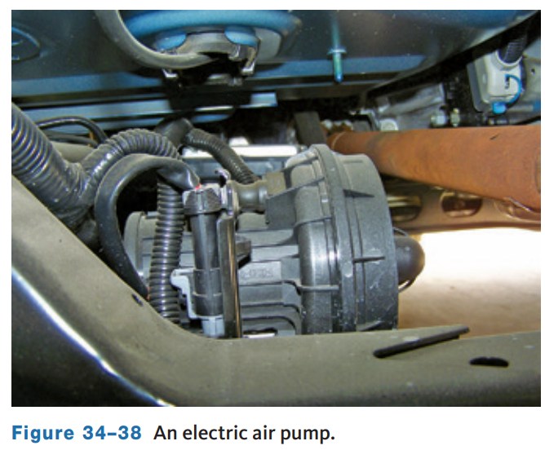
Secondary AIR Monitor
The operation of the secondary air injection (AIR) system is checked by an OBD II monitor.
The monitor looks at the complete electrical circuit for the AIR system, especially the electric pump (if so equipped) and pump relay.
Late-model AIR systems use an electric air pump controlled by the PCM.
These systems have an AIR solenoid and solenoid relay.
When the PCM provides a ground for the relay, battery voltage is applied to the solenoid and the pump.
A quick check of the system can be made with a scan tool.

Slide 37
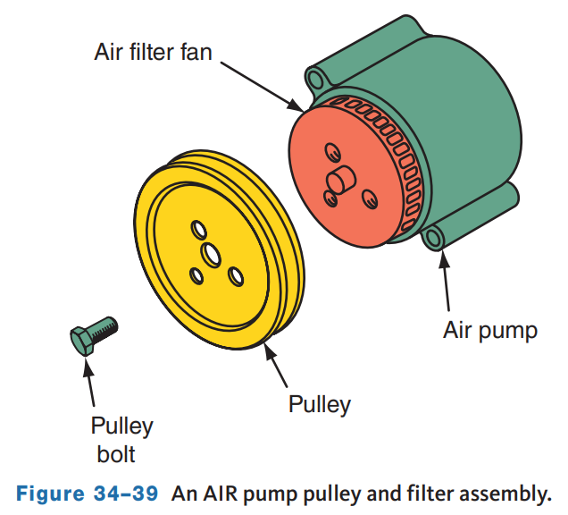
Secondary AIR System Service and Diagnosis
The first step in diagnosing a secondary air injection system is to check all vacuum hoses and electrical connections in the system.
Most belt-driven AIR pumps have a centrifugal filter behind the pulley to keep dirt out of the pump.
Air flows through this filter into the pump. The pulley and filter are bolted to the pump shaft and are serviced separately.
If the pulley or filter is bent, worn, or damaged, it should be replaced.
Also check the AIR pump’s belt for condition and tension and correct it as necessary. The pump assembly is usually not serviced.

Slide 38
Noise Diagnosis
Leaks in the AIR system can cause a noise.
It may sound like an exhaust leak or a hissing, depending on where the leak is.
To verify that the system is leaking, disconnect the pressure hose from the switching or combination valve.
Plug the end of the hose and run the pump.
Normally, the sound will be amplified and can be found.
The pump itself can be the source of a leak.
This typically results in a whistling noise when the pump is running.
At times, the source of the leak can be found by feeling around the pump as it runs.
A common source of leakage is a bad or loose seal at the pump shaft.
A pump problem can also be the cause of a noise.
One common pump noise is a rattling that is heard only when the pump is running.
The common cause of this noise is worn or damaged pump isolator mounts.

Slide 39
System Efficiency Test
When the AIR system is working properly, HC, CO, and CO₂ are decreased and O₂ is increased.
Run the engine at about 1,500 rpm with the secondary AIR system on (enabled).
Using an exhaust gas analyzer, measure and record the emission levels.
Next, disable the secondary AIR system and continue to allow the engine to idle.
Again, measure and record the emission levels in the exhaust gases.
The O₂ readings should be at least 4 percent less than they were when the AIR system was enabled.
Less than that indicates an AIR problem.

Slide 40
Discussion
There are many different emissions control systems and servicing each of them varies.
Have a class discussion while providing several examples of each system and how it is diagnosed and serviced.

Slide 41
Chapter Reflection
Please take a moment to compare your perception of emissions controls diagnosis and service before and after you studied this chapter. Then respond to the following questions in one or two paragraphs. Use 150–200 words in your reflection.
Were there any concepts in this chapter that you struggled to understand? What will you do to improve your understanding?
Given all you have learned, do you feel prepared to perform emissions controls diagnosis and service in a shop or lab setting? What will you do to better prepare?

